Slide 1
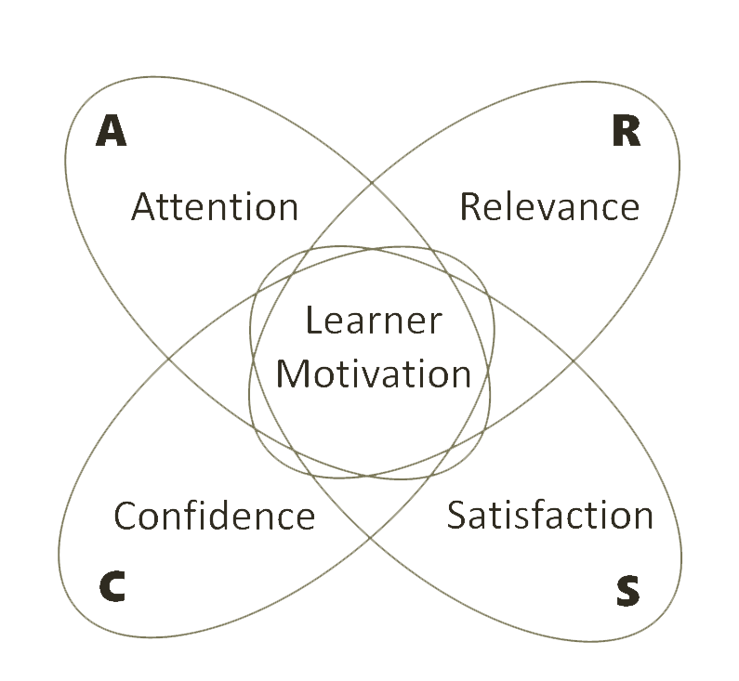
Design for Motivation using Keller’s ARCS Model
By Emily Morales

Slide 2
Why instructional design?
In maintaining dynamic learning for the purpose of keeping current with technological advances and knowledge that is changing, you often have to design/ adapt your own course materials

Slide 3
Why motivational design?
Motivation refers to the process whereby goal-directed behavior is activated and sustained (Driscoll, 2014).

Slide 4
Why motivational design?
“Motivation is an internal impulse that brings us to complete an action. Without motivation – there is no action,” (Cerdan, 2017).

Slide 5
Image retrieved from: https://www.dancecarmel.com/classes/ballet/

Slide 6
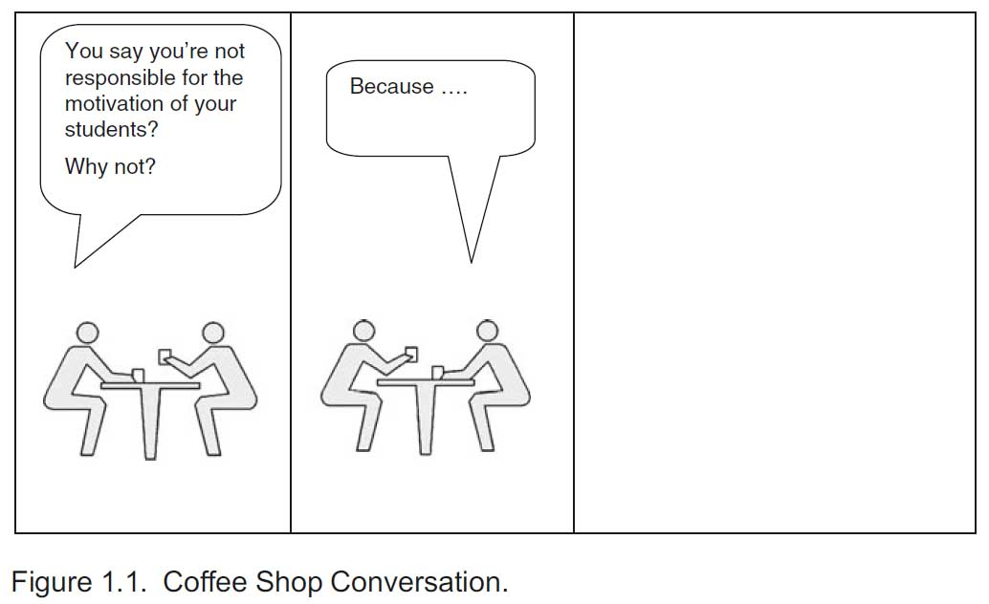
Overheard in a teacher’s lounge . . .
I don’t get to choose who is in my class
This is very serious content – a science course, not a fun and games “soft” course
My job is to teach, it’s up to students to want to learn - I can’t control their motivation
There’s no time to cover all the required content as it is – forget about motivational activities!

Slide 7
“Typically, motivation is viewed as highly unpredictable and changeable, subject to many influences over which the teacher or designer has no control,” (Keller, 1987, p. 2).

Slide 8
“. . . when it comes to inspiring interest in a school subject, the popular view is that it requires intuition and native talent,” (Keller, 1987, p. 2).

Slide 9
Models of Motivation
Maslow’s Self-Actualization
Deci & Ryan’s
Self-Determination Theory
Jeremy Bentham’s
“Carrot and Stick”
McGregor’s Participation Theory
Herzberg’s
Motivation Hygiene Theory
B.F. Skinner’s
Reinforcement Theory
McClelland’s Need Theory
Bandura’s Self-Efficacy Theory
Vroom’s Expectancy Theory

Slide 10
Keller’s ARCS Model of Motivation
A
R
Attention
Relevance
Learner
Motivation
Confidence
Satisfaction
C
For Instructional Design
S

Slide 11
Keller’s ARCS Model of Motivation
Introduced in the 1980’s, the Model is named after its author, John M. Keller.
Developed in response to perceived limitations of behaviorist and cognitive models of learning…

Slide 12
Keller’s ARCS Model of Motivation
365 pages of everything you would ever want to know about motivation is available as a free pdf!

Slide 13
Keller’s ARCS Model of Motivation
Model is comprised of four elements necessary for motivational instructional design:
Attention
Relevance
Confidence
Satisfaction
A
R
Attention
Relevance
Learner
Motivation
Confidence
Satisfaction
C
S

Slide 14
Attention
A
R
Attention
Relevance
Learner
Motivation
Confidence
Satisfaction
C
S
Keller’s ARCS Model of Motivation

Slide 15
Keller’s ARCS Model: Attention
Simply, to gather attention, the concern for the teacher is to direct attention to the appropriate stimuli (your lesson).

Slide 16
Keller’s ARCS Model: Attention
To accomplish this, you must respond to:
the sensation-seeking needs of students
and arouse knowledge-seeking curiosity
but without overstimulating them!

Slide 17
Keller’s ARCS Model: Attention
The goal is to find a balance between
boredom and indifference
hyperactivity and anxiety.
versus

Slide 18
Keller’s ARCS Model: Attention
Getting attention is the easy part; but is not enough…
You have to sustain attention.
Keller delineates many strategies to accomplish both of these objectives.

Slide 19
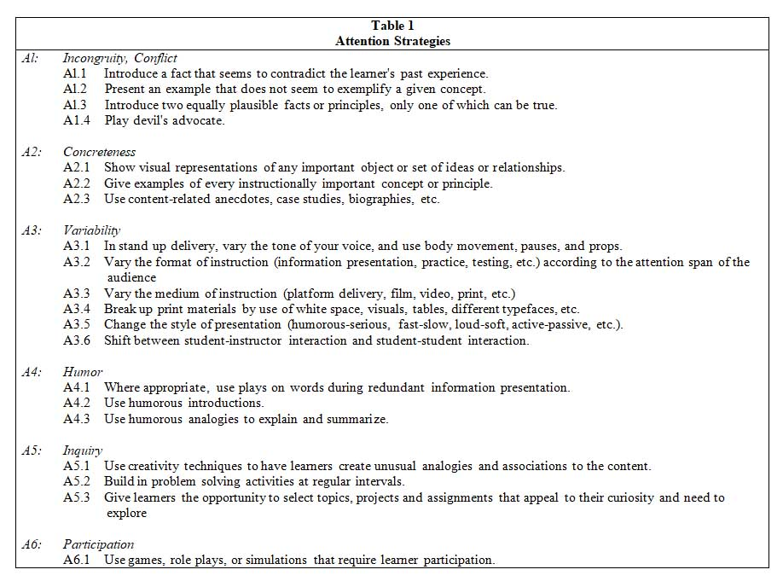
Keller’s ARCS Model: Attention
Table 1 – Attention Strategies from Keller (1987, p. 4).

Slide 20
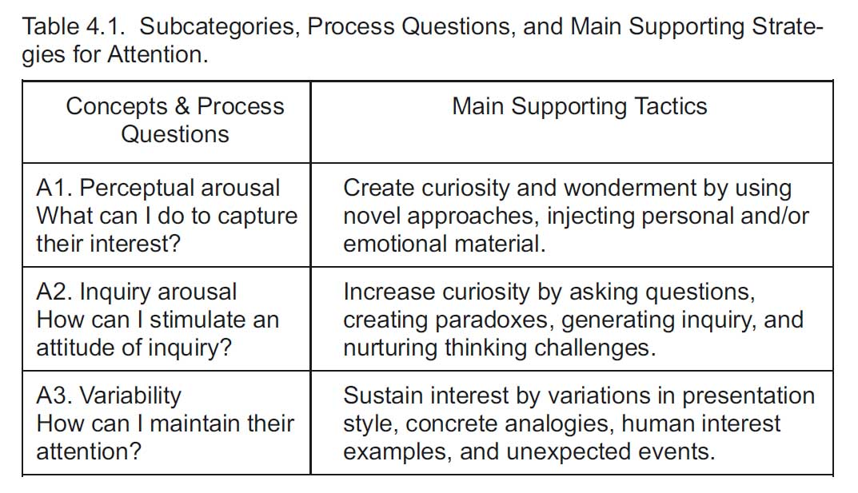
Keller’s ARCS Model: Attention
From Keller (2010, p. 92).

Slide 21
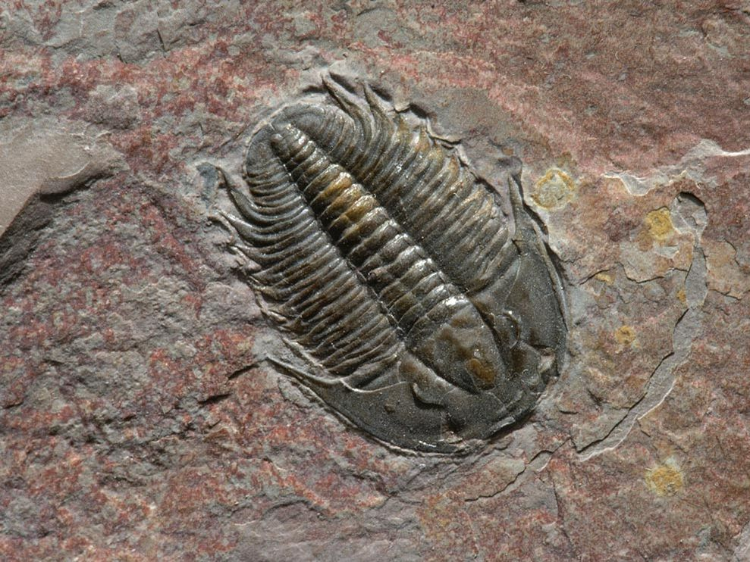
Keller’s ARCS Model: Attention
Perceptual Arousal – what can I do to capture student interest in the material?
Bring in a model of some kind

Slide 22
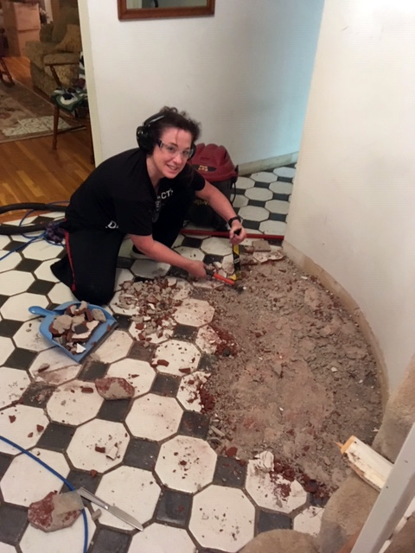
Keller’s ARCS Model: Attention
Perceptual Arousal – what can I do to capture student interest in the material?
Interject emotional material

Slide 23
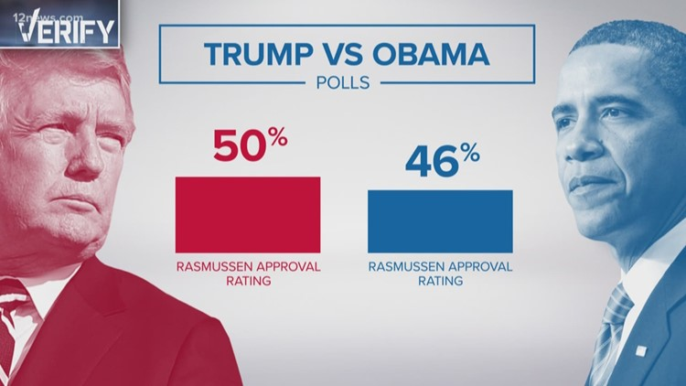
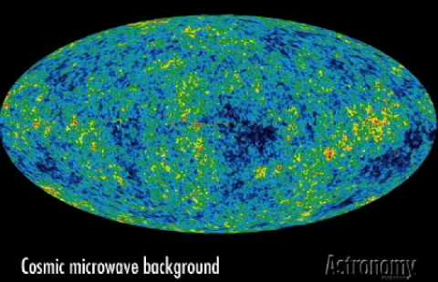
Keller’s ARCS Model: Attention
Inquiry Arousal – How to stimulate an attitude of safe inquiry to sustain interest?
Introduce a fact that seems to contradict the learner’s past experience

Slide 24
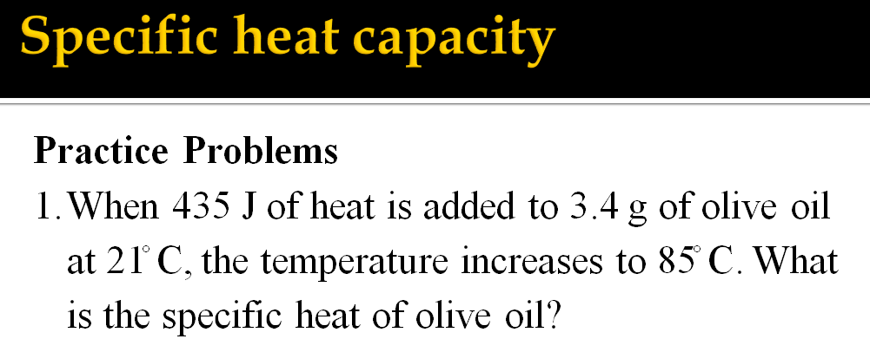
Keller’s ARCS Model: Attention
Inquiry Arousal – How to stimulate an attitude of safe inquiry to sustain interest?
Ask questions, introduce problem solving exercises to work on in teams

Slide 25
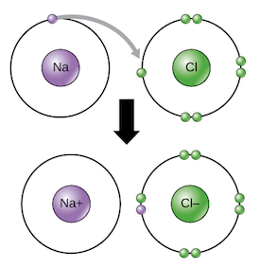
Keller’s ARCS Model: Attention
Inquiry Arousal – How to stimulate an attitude of safe inquiry to sustain interest?
Use humorous analogies to explain and summarize concepts

Slide 26
Keller’s ARCS Model: Attention
Variability – how to maintain attention?
Variations in presentation style – use video, print media, audio, demonstrations
Provide concrete analogies, such as case studies, biographies, examples of important concepts
Link what they are learning to what they already know (remember working memory and the function of retrieving already-existing schema from long-term memory?)

Slide 27
Relevance
A
R
Attention
Relevance
Learner
Motivation
Confidence
Satisfaction
C
S
Keller’s ARCS Model of Motivation

Slide 28
Keller’s ARCS Model: Relevance
“Relevance, in it’s most general sense, refers to those things which we perceive as instrumental in meeting needs and satisfying personal desires, including the accomplishments of personal goals,” (Keller, 1987, p.3).

Slide 29
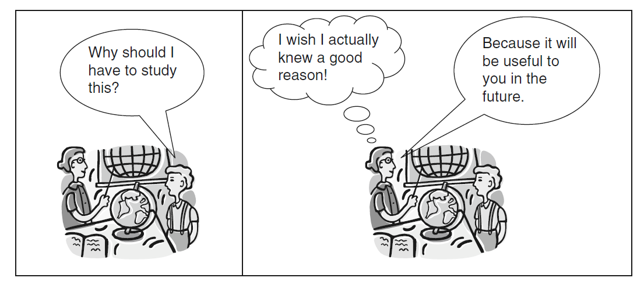
Keller’s ARCS Model: Relevance
From Keller (2010, p. 97).
“. . . the teacher or trainer must have a clear belief in the relevance of the content before being able to convince the students!” (Keller, 2010, p. 97).

Slide 30
Keller’s ARCS Model: Relevance
Neurology of relevance
Consequences of neural plasticity
“It is likely that the brain develops a hierarchy of salience and, based on its limited processing capacity, processes only what is most salient,” (Wilhelm, Diekelmann, Molzow, Ayoub, Molle, & Born, 2011, p. 1568).

Slide 31
Keller’s ARCS Model: Relevance
Neurology of relevance
Consequences of neural plasticity
When learners designate an environmental stimulus (learning event) as “relevant,” they place a value upon it…
Consequently, the event will undergo consolidation during a sleep cycle, and it will be remembered later (Wilhelm et al., 2011).

Slide 32
Keller’s ARCS Model: Relevance
Neurology of relevance
Consequences of neural plasticity
By contrast, when they consider a learning event as “irrelevant,” placing very little value on it, the event will not undergo memory consolidation
It will be “pruned” from the memory system, and the event will be forgotten (Wilhelm et al., 2011).

Slide 33
Keller’s ARCS Model: Relevance
Pollack and Cabane (2016) have likened glial cells as the fastidious gardeners of your brain, acting to speed up signals between certain neurons, and pruning other signals.

Slide 34
Keller’s ARCS Model: Relevance
Other glial cells act as waste removers, pulling up weeds, killing pests, raking up dead leaves.

Slide 35
Keller’s ARCS Model: Relevance
But, when everything is working, after restful sleep (or even naps), the brain is restored, as ordered as a manicured Japanese garden.
“Thinking with a sleep-deprived brain is like hacking your way through a dense jungle with a machete. Its overgrown, slow going, exhausting...” (Pollack & Cabane, 2016).

Slide 36
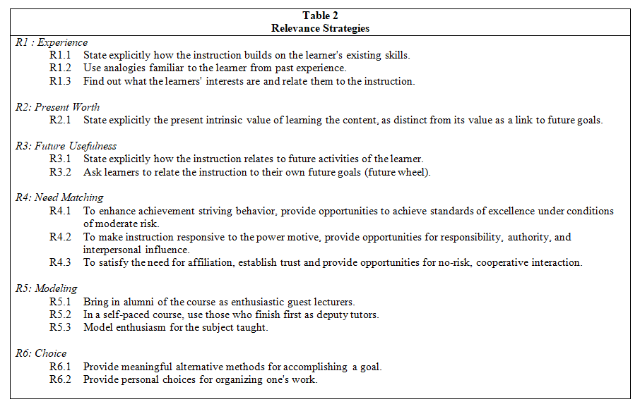
Keller’s ARCS Model: Relevance

Slide 37
Keller’s ARCS Model: Relevance
Present worth – emphasize what the subject matter can do for the student today.
Future worth – explain what the subject matter will do for them in the future.
Familiarity – tie the instruction to the learner’s experience – outside the class.

Slide 38
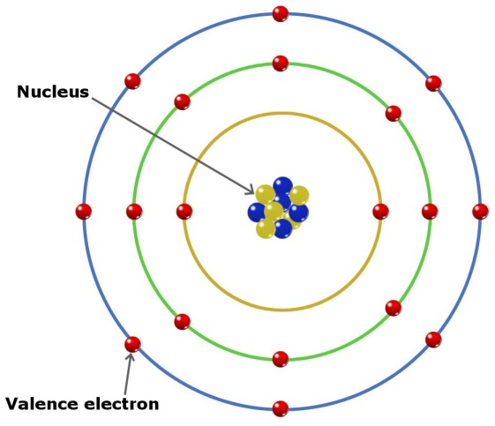
Keller’s ARCS Model: Relevance
Question: What can you say to a chemistry student learning quantum mechanics with no plans for a technical program in college?

Slide 39
Keller’s ARCS Model: Relevance
At times the course content itself does not have much relevance to learners, but all is not lost – students will not necessarily scream or snore…
You can keep the course relevant by satisfying other learner needs.

Slide 40
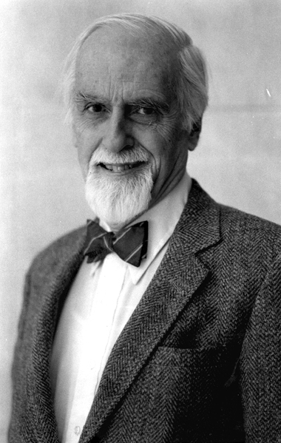
Keller’s ARCS Model: Relevance
David McClelland and colleagues identified other factors which contribute to course relevance and learner motivation:
Need for Achievement – the urge to excel or accomplish something of significance in relation to set standards
Need for Affiliation – desire for open and sociable interpersonal relationships
Need for Power – the desire to have influence over other peoples behavior (either good or bad)

Slide 41
Confidence
A
R
Attention
Relevance
Learner
Motivation
Confidence
Satisfaction
Keller’s ARCS Model of Motivation
C
S

Slide 42
Keller’s ARCS Model: Confidence
Keller (2010) states, “. . . confidence refers generally to people’s expectancies for success in the various parts of their lives.”
The degree of confidence a learner has is correlative with their perception of control.
Question for us: “How can I help students succeed and believe in their ability to control their successes?”

Slide 43
Keller’s ARCS Model: Confidence
A tale of two students (from Keller 2010)
Assigned a term paper from:
Charlie
Carolyn

Slide 44
Keller’s ARCS Model: Confidence
A tale of two students (from Keller 2010)
Charlie is expecting an A, but receives a B.
Dude! The instructor TOTALLY didn’t provide clear enough instructions!
Charlie
Carolyn

Slide 45
Keller’s ARCS Model: Confidence
A tale of two students (from Keller 2010)
Carolyn was also expecting an A, but receives a B.
Perhaps I didn’t fully understand the instructions, or I didn’t try hard enough.
Charlie
Carolyn

Slide 46
Keller’s ARCS Model: Confidence
A tale of two students (from Keller 2010)
For the sake of argument, let’s assume the term papers were comparable, and the grading standards were fairly objective.
Charlie
Carolyn

Slide 47
Keller’s ARCS Model: Confidence
A tale of two students (from Keller 2010)
Unnamed teacher might respond:
Carolyn, since you believe you will be rewarded appropriately for your own hard work, you have an internal locus of control.
Carolyn

Slide 48
Keller’s ARCS Model: Confidence
A tale of two students (from Keller 2010)
Charlie, since you believe any rewards you receive depend upon luck, personal favor, or other uncontrollable influences, you have an external locus of control.
Charlie

Slide 49
Keller’s ARCS Model: Confidence
Locus of Control - Coined in 1966 by Rotter
Internal – “[p]eople who believe they will be rewarded appropriately by means of grades, recognition, money, privileges, or other tangible outcomes if they do a good job are considered to have an internal locus of control,” (Keller, 2010, p. 138).

Slide 50
Keller’s ARCS Model: Confidence
Locus of Control - Coined in 1966 by Rotter
External – “[p]eople who believe that being rewarded depends on luck, personal favor, or other uncontrollable influences, regardless of how well or poorly they achieve, are considered to have an external locus of control,” (Keller, 2010, pp. 138, 139).

Slide 51
Keller’s ARCS Model: Confidence
Facilitate an internal locus of control…
Students are more motivated to work hard, if they believe they have some control over their learning outcomes.

Slide 52
Keller’s ARCS Model: Confidence
Facilitate an internal locus of control…
Let’s visit Carol S. Dweck’s work on Growth vs. Fixed mindsets!

Slide 53
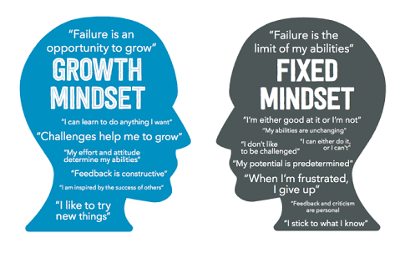
Keller’s ARCS Model: Confidence

Slide 54
Keller’s ARCS Model: Confidence
As teacher’s we can do much to facilitate a classroom environment that fosters a growth mindset.
Be mindful of your PRAISE!

Slide 55
Satisfaction
A
R
Attention
Relevance
Learner
Motivation
Confidence
Satisfaction
Keller’s ARCS Model of Motivation
S
C

Slide 56
Keller’s ARCS Model: Satisfaction
Intrinsic motivation, which can also be called intrinsic satisfaction, comes from:
Feelings of mastery
From the pleasure of having succeeded at a task which was meaningful and challenging
Feeling competent in areas of personal interest
Having a sense of control over your own success

Slide 57
Keller’s ARCS Model: Satisfaction
When learners are intrinsically motivated, they are enjoying satisfaction from the task itself - not necessarily for any external rewards they may receive for task mastery.
By contrast, extrinsic motivation refers to behaviors that are driven by external rewards such as grades, money, praise, and recognition.

Slide 58
Keller’s ARCS Model: Satisfaction
Tips for rewarding student outcomes effectively (Keller, 2010, pp. 190, 191):
Include games with scoring systems to provide an extrinsic reward system for routine, boring tasks such as drill and practice.
Use extrinsic rewards to reinforce intrinsically interesting tasks in an unexpected, non-controlling, manner.
Include congratulatory comments for correct responses.
Give students personal attention while working to accomplish the task, or after successful task accomplishment.

Slide 59
Keller’s ARCS Model: Satisfaction
Tips for rewarding student outcomes effectively (Keller, 2010, pp. 190, 191):
Use reinforcements frequently when learners are trying to master a new skill.
Use reinforcements more intermittently as learners become more competent at a task.
Avoid threats and surveillance as means of obtaining task performance.
Use certificates or ‘‘symbolic’’ rewards to reward success in individual or intergroup competitions, or at the end of a course.

Slide 60
Keller’s ARCS Model Mini Quiz

Slide 61
Keller’s ARCS Model – Mini Quiz
1. What does the “A” in Keller’s ARCS Model stand for?
Attention

Slide 62
Keller’s ARCS Model – Mini Quiz
2. What does the “R” stand for in Keller’s ARCS Model?
Relevance

Slide 63
Keller’s ARCS Model – Mini Quiz
3. What does the “C” stand for in Keller’s ARCS Model?
Confidence

Slide 64
Keller’s ARCS Model – Mini Quiz
4. What does the “S” stand for in Keller’s ARCS Model?
Satisfaction

Slide 65
Keller’s ARCS Model – Mini Quiz
5. Which kind of satisfaction involves being satisfied with the task itself?
Intrinsic satisfaction

Slide 66
Keller’s ARCS Model – Mini Quiz
6. Rand came in third place in a race at school, then remarked, “The race was rigged from the start – I didn’t have a chance.”
Which mindset (fixed or growth) did he demonstrate here?
Fixed

Slide 67
Keller’s ARCS Model – Mini Quiz
Mrs. Morales, marveling at the brilliant answers provided by her student Jack, praised him as follows: “Jack, you are so very talented and intelligent. Your mother must be so very proud of you.”
Which mindset is Mrs. Morales reinforcing with that kind of praise?
Fixed

Slide 68
Keller’s ARCS Model – Mini Quiz
In the example provided earlier of Carolyn and Charlie, what was the source of the locus of control for Carolyn?
Internal

Slide 69
Keller’s ARCS Model – Mini Quiz
9. A learner possesses a(n) __________ locus of control if they believe there is little they can personally do for academic success.
external

Slide 70
Keller’s ARCS Model – Mini Quiz
10. Which of the four elements of the ARCS model is impacted when you bring models or maps in to the class?
Attention

Slide 71
Keller’s ARCS Model – Mini Quiz
11. Which of the four elements of the ARCS model is impacted when you emphasize the future worth of a subject they are studying?
Relevance

Slide 72
Keller’s ARCS Model – Mini Quiz
Which of the four elements of the ARCS model is impacted when you offer an extrinsic reward for winning in a team competition?
Satisfaction

Slide 73
References
Cerdan, A.G. (2017). The importance of motivation: What it is and tips to promote it. Retrieved from: https://blog.cognifit.com/importance-of-motivation-learning-tips/
Driscoll, M. P. (2005). Psychology of learning for instruction, 3rd Ed. Pearson Education.
Keller, J. M. (2009). Motivational design for learning and performance: The ARCS model approach. Springer Science & Business Media.
Pollack, J., Cabane, O.F. (2016). Your brain has a delete button – here’s how to use it. Retrieved from: https://www.fastcompany.com/3059634/your-brain-has-a-delete-button-heres-how-to-use-it
Wilhelm, I., Diekelmann, S., Molzow, I., Ayoub, A., Mölle, M., & Born, J. (2011). Sleep selectively enhances memory expected to be of future relevance. Journal of Neuroscience, 31(5), 1563-1569.

Slide 74
Image Credits
Image of five young ballet dancers retrieved from: https://www.dancecarmel.com/classes/ballet/
Photo of John M. Keller retrieved from: https://www.arcsmodel.com/
Image of bored students retrieved from: https://partnerinedu.com/2013/09/06/the-search-for-meaning-in-literary-motifs-supporting-cc-literacy-standards-1-2-4-5/
Image of bored little girl retrieved from: https://childbehaviorsolution.blogspot.com/
Image of hyperactive little girl retrieved from: https://juliaharrisonclassroommanagement.weebly.com/hyperactive-impulsive.html
Trilobite image retrieved from: http://whataearth.com/product/trilobite
Missionary map image retrieved from: https://bostonraremaps.com/inventory/colton-1878-missionary-map-world/
Woman screaming image retrieved from: http://www.redstate.com/
Trump approval rating poll results retrieved from: http://www.12news.com/video/news/local/verify/verify-is-president-trumps-approval-rating-higher-than-president-obama/75-8065839
Sleeping student image retrieved from: https://www.learningliftoff.com/causes-and-cures-for-classroom-boredom/

Slide 75
Image Credits
Image of sleeping brain retrieved from: https://www.zmescience.com/medicine/mind-and-brain/brain-circuit-sleep-wake/
Image of manicured gardens retrieved from: https://www.thetreecenter.com/plants-japanese-garden/
Image of overgrown jungle retrieved from: http://www.dailymail.co.uk/travel/travel_news/article-6117795/To-rust-ruin-forgotten-things-left-crumble.html
Pondering teen male image retrieved from: http://www.mountainheightsacademy.org/more-tips-for-applying-to-colleges/portrait-of-handsome-teenage-boy-thinking/
Image of electron arrangement in Argon, retrieved from: https://www.scienceabc.com/pure-sciences/how-to-find-the-number-of-valence-electrons-in-an-element.html
Screaming girl retrieved from: https://www.istockphoto.com/videos/girl-scream?offlinecontent=include&assettype=film&sort=mostpopular&phrase=girl%20scream
Image of Carol S. Dweck retrieved from: http://news.stanford.edu/2015/04/29/dweck-kids-potential-042915/

